Slide 1
Index Construction

Slide 2
Plan
Last lecture:
  Dictionary data structures
  Tolerant retrieval
    Wildcards
    Spell correction
    Soundex
This time:
  Index construction
a-hu
hy-m
n-z
$m
mace
madden
mo
among
amortize
on
abandon
among

Slide 3
Index construction
Ch. 4
How do we construct an index?
What strategies can we use with limited main memory?

Slide 4
Hardware basics
Sec. 4.1
Many design decisions in information retrieval are based on the characteristics of hardware
We begin by reviewing hardware basics

Slide 5
Hardware basics
Sec. 4.1
Access to data in memory is much faster than access to data on disk.
Disk seeks: No data is transferred from disk while the disk head is being positioned.
Therefore: Transferring one large chunk of data from disk to memory is faster than transferring many small chunks.
Disk I/O is block-based: Reading and writing of entire blocks (as opposed to smaller chunks).

Slide 6
Hardware basics
Sec. 4.1
Servers used in IR systems now typically have several GB of main memory, sometimes tens of GB.
Available disk space is several (2–3) orders of magnitude larger than main memory.
Fault tolerance is very expensive: It’s much cheaper to use many regular machines rather than one fault tolerant machine.

Slide 7
Hardware assumptions for this lecture
Sec. 4.1
symbol statistic value
s average seek time 5 ms = 5 x 10⁻³ s
b transfer time per byte 0.02 μs = 2 x 10⁻⁸ s
processor’s clock rate 10⁹ s⁻¹
p low-level operation 0.01 μs = 10⁻⁸ s
  (e.g., compare & swap a word)
size of main memory several GB
size of disk space 1 TB or more

Slide 8
BSBI: Blocked sort-based Indexing

Slide 9
RCV1: Our collection for this lecture
Sec. 4.2
Shakespeare’s collected works definitely aren’t large enough for demonstrating many of the points in this course.
The collection we’ll use isn’t really large enough either, but it’s publicly available and is at least a more plausible example.
As an example for applying scalable index construction algorithms, we will use the Reuters RCV1 collection.
This is one year of Reuters newswire (part of 1995 and 1996)

Slide 10

A Reuters RCV1 document
Sec. 4.2

Slide 11
Reuters RCV1 statistics
Sec. 4.2
symbol statistic value
N documents 800,000
L avg. # tokens per doc 200
M terms (= word types) 400,000
avg. # bytes per token 6
  (incl. spaces/punct.)
avg. # bytes per token 4.5
    (without spaces/punct.)
avg. # bytes per term 7.5
non-positional postings 100,000,000
4.5 bytes per word token vs. 7.5 bytes per word type: why?

Slide 12
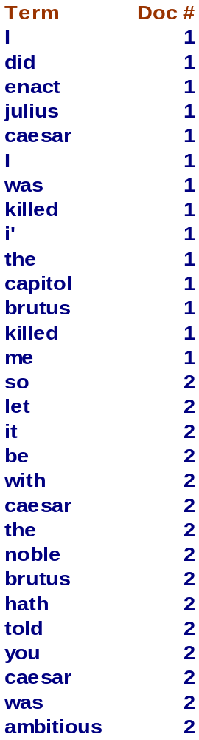
Recall index construction
Sec. 4.2
Documents are parsed to extract words and these are saved with the Document ID.
Doc 1
Doc 2
I did enact Julius
Caesar I was killed
i' the Capitol;
Brutus killed me.
So let it be with
Caesar. The noble
Brutus hath told you
Caesar was ambitious

Slide 13
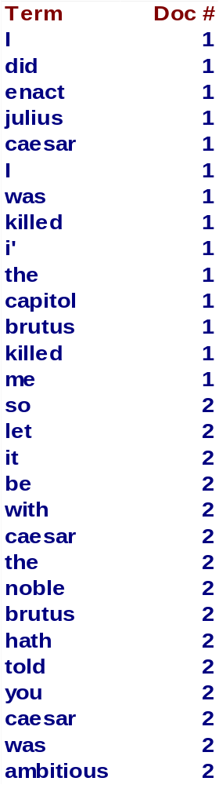
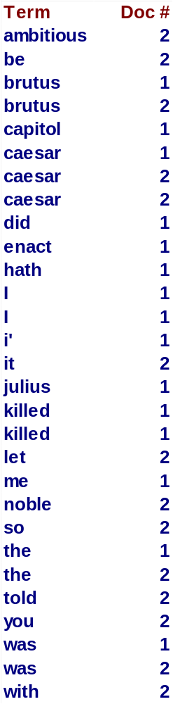
Key step
Sec. 4.2
After all documents have been parsed, the inverted file is sorted by terms.
We focus on this sort step.
We have 100M items to sort.

Slide 14
Scaling index construction
Sec. 4.2
In-memory index construction does not scale
  Can’t stuff entire collection into memory, sort, then write back
How can we construct an index for very large collections?
Taking into account the hardware constraints we just learned about . . .
Memory, disk, speed, etc.

Slide 15
Sort-based index construction
Sec. 4.2
As we build the index, we parse docs one at a time.
At 8 bytes per non-positional postings entry (termID, docID), demands a lot of space for large collections.
T = 100,000,000 in the case of RCV1
  So … we can do this in memory in 2009, but typical collections are much larger. E.g., the New York Times provides an index of >150 years of newswire
Thus: We need to store intermediate results on disk.

Slide 16
Sort using disk as “memory”?
Sec. 4.2
Can we use the same index construction algorithm for larger collections, but by using disk instead of memory?
No: Sorting T = 100,000,000 records on disk is too slow – too many disk seeks.
We need an external sorting algorithm.

Slide 17
Bottleneck
Sec. 4.2
Parse and build postings entries one doc at a time
Now sort postings entries by term (then by doc within each term)
Doing this with random disk seeks would be too slow – must sort T=100M records
If every comparison took 2 disk seeks, and N items could be
sorted with N log₂N comparisons, how long would this take?

Slide 18
BSBI: Blocked sort-based Indexing (Sorting with fewer disk seeks)
Sec. 4.2
8-byte (4+4) records (termID, docID).
These are generated as we parse docs.
Must now sort 100M such 8-byte records by termID.
Define a Block ~ 10M such records
  Can easily fit a couple into memory.
  Will have 10 such blocks to start with.
Basic idea of algorithm:
  Accumulate postings for each block, sort, write to disk.
  Then merge the blocks into one long sorted order.

Slide 19
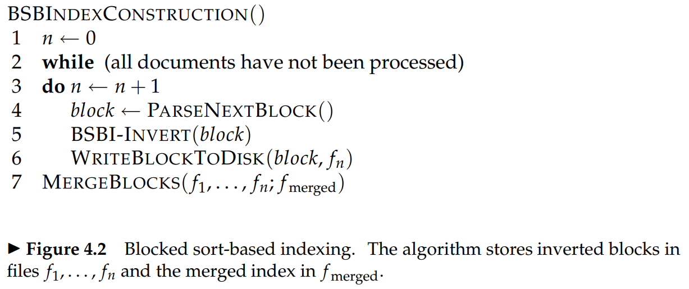
Sec. 4.2

Slide 20
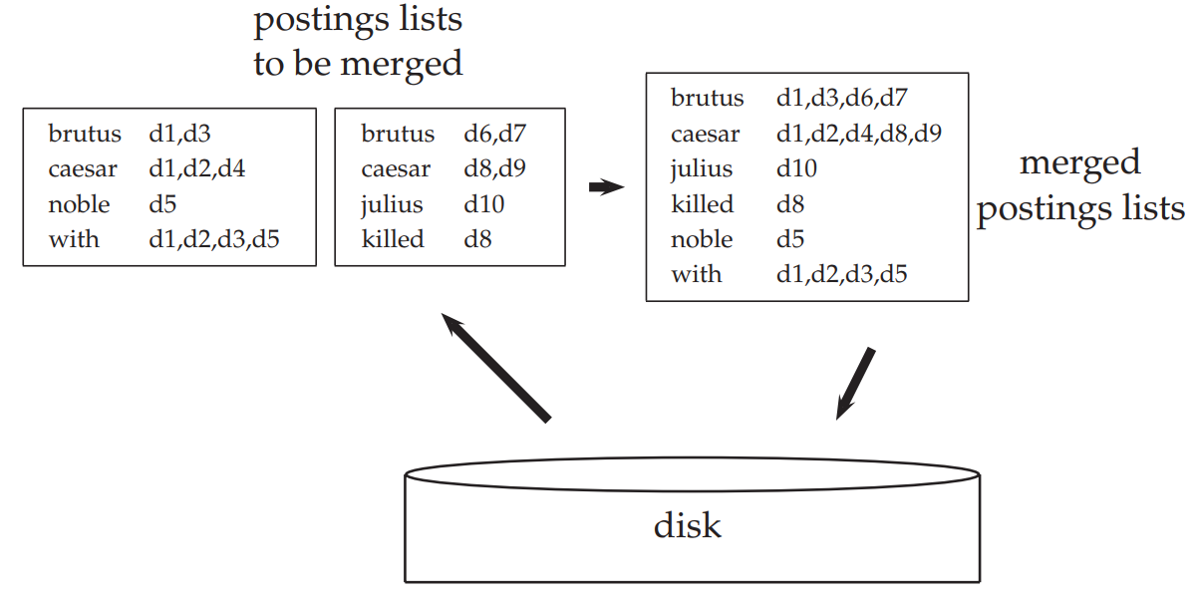
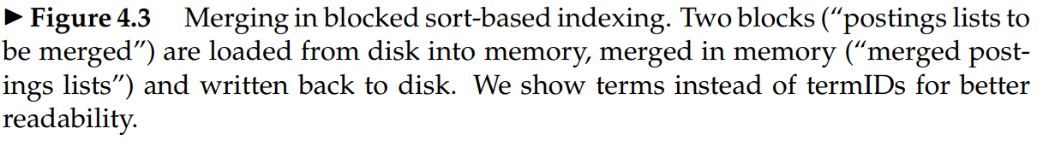
Sec. 4.2

Slide 21
Sorting 10 blocks of 10M records
Sec. 4.2
First, read each block and sort within:
  Quicksort takes 2N ln N expected steps
  In our case 2 x (10M ln 10M) steps
Exercise: estimate total time to read each block from disk and and quicksort it.
10 times this estimate – gives us 10 sorted runs of 10M records each.
Done straightforwardly, need 2 copies of data on disk
  But can optimize this

Slide 22
How to merge the sorted runs?
Sec. 4.2
Can do binary merges, with a merge tree of log₂10 = 4 layers.
During each layer, read into memory runs in blocks of 10M, merge, write back.

Slide 23
How to merge the sorted runs?
Sec. 4.2
But it is more efficient to do a multi-way merge, where you are reading from all blocks simultaneously
Providing you read decent-sized chunks of each block into memory and then write out a decent-sized output chunk.

Slide 24
SPIMI:
Single-pass in-memory indexing

Slide 25
Remaining problem with sort-based algorithm
Sec. 4.3
Our assumption was: we can keep the dictionary in memory.
We need the dictionary (which grows dynamically) in order to implement a term to termID mapping.
Actually, we could work with term,docID postings instead of termID,docID postings . . .
. . . but then intermediate files become very large. (We would end up with a scalable, but very slow index construction method.)

Slide 26
SPIMI:
Single-pass in-memory indexing
Sec. 4.3
Key idea 1: Generate separate dictionaries for each block – no need to maintain term-termID mapping across blocks.
Key idea 2: Don’t sort. Accumulate postings in postings lists as they occur.
With these two ideas we can generate a complete inverted index for each block.
These separate indexes can then be merged into one big index.

Slide 27
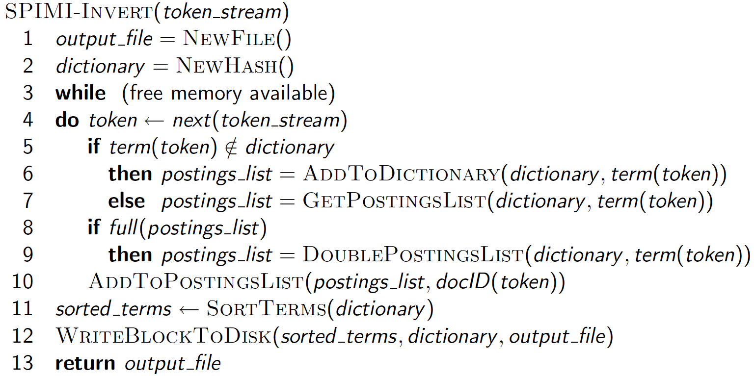
SPIMI-Invert
Sec. 4.3
Merging of blocks is analogous to BSBI.

Slide 28
SPIMI: Compression
Sec. 4.3
Compression makes SPIMI even more efficient.
  Compression of terms
  Compression of postings
See next lecture

Slide 29
Distributed indexing

Slide 30
Distributed indexing
Sec. 4.4
For web-scale indexing (don’t try this at home!):
  must use a distributed computing cluster
Individual machines are fault-prone
  Can unpredictably slow down or fail
How do we exploit such a pool of machines?

Slide 31
Web search engine data centers
Sec. 4.4
Web search data centers (Google, Bing, Baidu) mainly contain commodity machines.
Data centers are distributed around the world.
Estimate: Google ~1 million servers, 3 million processors/cores (Gartner 2007)

Slide 32
Massive data centers
Sec. 4.4
If in a non-fault-tolerant system with 1000 nodes, each node has 99.9% uptime, what is the uptime of the system?
Answer: 36.8%
Notes:
0.999^1000

Slide 33
Distributed indexing
Sec. 4.4
Maintain a master machine directing the indexing job – considered “safe”.
Break up indexing into sets of (parallel) tasks.
Master machine assigns each task to an idle machine from a pool.

Slide 34
Parallel tasks
Sec. 4.4
We will use two sets of parallel tasks
  Parsers
  Inverters
Break the input document collection into splits
Each split is a subset of documents (corresponding to blocks in BSBI/SPIMI)

Slide 35

Provided by the programmer
Provided by the programmer
MAP:
Read input and produces a set of key-value pairs
Group by key:
Collect all pairs with same key
Reduce:
Collect all values belonging to the key and output
The crew of the space shuttle Endeavor recently returned to Earth as ambassadors, harbingers of a new era of space exploration. Scientists at NASA are saying that the recent assembly of the Dextre bot is the first step in a long-term space-based man/mache partnership. '"The work we're doing now -- the robotics we're doing -- is what we're going to need ……………………..
(The, 1)
(crew, 1)
(of, 1)
(the, 1)
(space, 1)
(shuttle, 1)
(Endeavor, 1)
(recently, 1)
….
(crew, 1)
(crew, 1)
(space, 1)
(the, 1)
(the, 1)
(the, 1)
(shuttle, 1)
(recently, 1)
…
(crew, 2)
(space, 1)
(the, 3)
(shuttle, 1)
(recently, 1)
…
Sequentially read the data
Only sequential reads
Big document
(key, value)
(key, value)
(key, value)

Slide 36

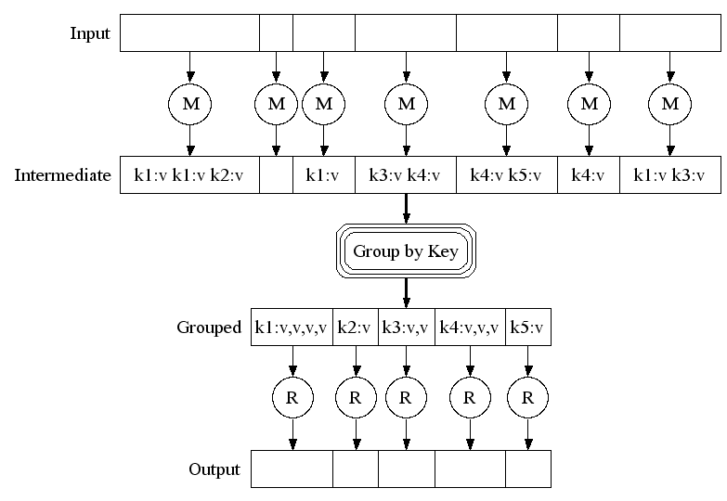
Big document
MAP:
Read input and produces a set of key-value pairs
Group by key:
Collect all pairs with same key
(Hash merge, Shuffle, Sort, Partition)
Reduce:
Collect all values belonging to the key and output

Slide 37
Data flow
Sec. 4.4
assign
Master
assign
Postings
Parser
a-f
g-p
q-z
Inverter
a-f
Parser
a-f
g-p
q-z
Inverter
g-p
splits
Inverter
q-z
Parser
a-f
g-p
q-z
Map
phase
Reduce
phase
Segment files

Slide 38
Parsers
Sec. 4.4
Master assigns a split to an idle parser machine
Parser reads a document at a time and emits (term, docID) pairs
Parser writes pairs into j partitions
Each partition is for a range of terms’ first letters
  (e.g., a-f, g-p, q-z) – here j = 3.
Now to complete the index inversion

Slide 39
Inverters
Sec. 4.4
An inverter collects all (termID,docID) pairs (= postings) for one term-partition.
Sorts and writes to postings lists

Slide 40
MapReduce
Sec. 4.4
The index construction algorithm we just described is an instance of MapReduce.
MapReduce (Dean and Ghemawat 2004) is a robust and conceptually simple framework for distributed computing …
… without having to write code for the distribution part.
They describe the Google indexing system (ca. 2002) as consisting of a number of phases, each implemented in MapReduce.

Slide 41
MapReduce
Sec. 4.4
Index construction was just one phase.
Another phase: transforming a term-partitioned index into a document-partitioned index.
  Term-partitioned: one machine handles a subrange of terms
  Document-partitioned: one machine handles a subrange of documents
As we’ll discuss in the web part of the course, most search engines use a document-partitioned index … better load balancing, etc.

Slide 42
Schema for index construction in MapReduce
Sec. 4.4
Schema of map and reduce functions
map: input → list(k, v) reduce: (k,list(v)) → output
Instantiation of the schema for index construction
map: collection → list(termID, docID)
reduce: (<termID1, list(docID)>, <termID2, list(docID)>, …) → (postings list1, postings list2, …)
Notes:
instantiation英 [ɪnstænʃɪ'eɪʃən] 美 [ɪnstænʃɪ'eɪʃən] n.实例化，例示

Slide 43
Example for index construction
Map:
d1 : Caesar came, Caesar conquered.
d2 : Caesar died. →
< Caesar,d1>, <came,d1>, < Caesar,d1>, < conquered, d1>, < Caesar, d2>, <died,d2>
Reduce:
(< Caesar,(d1,d1,d2)>, <died,(d2)>, <came,(d1)>, < conquered,(d1)>) →
  (< Caesar,(d1:2,d2:1)>, <died,(d2:1)>, <came,(d1:1)>, < conquered,(d1:1)>)

Slide 44
Dynamic indexing

Slide 45
Dynamic indexing
Sec. 4.5
Up to now, we have assumed that collections are static.
However, they rarely are static, because:
  Documents come in over time and need to be inserted.
  Documents are deleted and modified.
This means that the dictionary and postings lists have to be modified:
  Postings updates for terms already in dictionary
  New terms added to dictionary

Slide 46
Simplest approach
Sec. 4.5
Maintain “big” main index
New docs go into “small” auxiliary index
Search across both, merge results
Deletions
  Invalidation bit-vector for deleted docs
  Filter docs output on a search result by this invalidation bit-vector
Periodically, re-index into one main index
Notes:
auxiliary英 [ɔ:gˈzɪliəri] 美 [ɔɡˈzɪljəri, -ˈzɪləri] adj.辅助的;备用的，补充的;附加的;副的n.助动词;辅助者，辅助人员;附属机构，附属团体;辅助设备
invalidation英 [ɪnˌvælɪ'deɪʃn] 美 [ɪnˌvælɪ'deɪʃn] n.无效，失效

Slide 47
Issues with main and auxiliary indexes
Sec. 4.5
Problem of frequent merges – you touch stuff a lot
Poor performance during merge
Actually:
  Merging of the auxiliary index into the main index is efficient if we keep a separate file for each postings list.
  Merge is the same as a simple append.
  But then we would need a lot of files – inefficient for OS.
Assumption for the rest of the lecture: The index is one big file.
In reality: Use a scheme somewhere in between (e.g., split very large postings lists, collect postings lists of length 1 in one file etc.)

Slide 48
Logarithmic merge
Sec. 4.5
Maintain a series of indexes, each twice as large as the previous one
  At any time, some of these powers of 2 are instantiated
Keep smallest (Z₀) in memory
Larger ones (I₀, I₁, …) on disk
If Z₀ gets too big (> n), write to disk as I₀
or merge with I₀ (if I₀ already exists) as Z₁
Either write merge Z₁ to disk as I₁ (if no I₁)
Or merge with I₁ to form Z₂

Slide 49
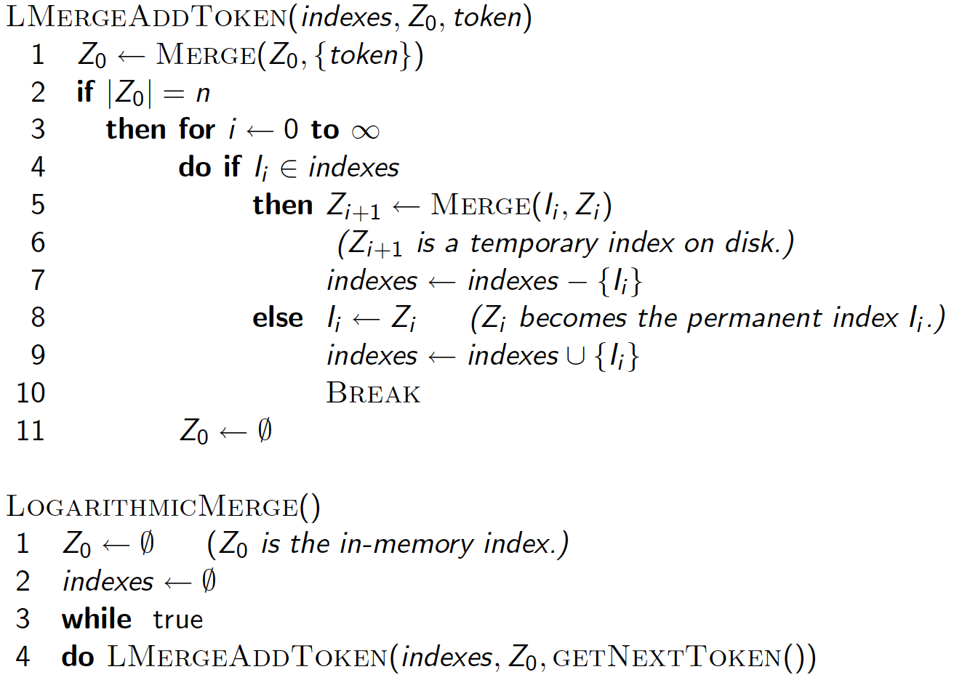
Sec. 4.5

Slide 50
Logarithmic merge
Sec. 4.5
Auxiliary and main index: index construction time is O(T²) as each posting is touched in each merge.
Logarithmic merge: Each posting is merged O(log T) times, so complexity is O(T log T)
So logarithmic merge is much more efficient for index construction
But query processing now requires the merging of O(log T) indexes
  Whereas it is O(1) if you just have a main and auxiliary index

Slide 51
Further issues with multiple indexes
Sec. 4.5
Collection-wide statistics are hard to maintain
E.g., when we spoke of spell-correction: which of several corrected alternatives do we present to the user?
  We said, pick the one with the most hits
How do we maintain the top ones with multiple indexes and invalidation bit vectors?
  One possibility: ignore everything but the main index for such ordering
Will see more such statistics used in results ranking

Slide 52
Dynamic indexing at search engines
Sec. 4.5
All the large search engines now do dynamic indexing
Their indices have frequent incremental changes
  News items, blogs, new topical web pages
    Sarah Palin, …
But (sometimes/typically) they also periodically reconstruct the index from scratch
  Query processing is then switched to the new index, and the old index is deleted

Slide 53

Sec. 4.5
Notes:
Webmasterworld. Search Engine watch.

Slide 54
Other sorts of indexes
Sec. 4.5
Positional indexes
  Same sort of sorting problem … just larger
Building character n-gram indexes:
  As text is parsed, enumerate n-grams.
  For each n-gram, need pointers to all dictionary terms containing it – the “postings”.
  Note that the same “postings entry” will arise repeatedly in parsing the docs – need efficient hashing to keep track of this.
    E.g., that the trigram uou occurs in the term deciduous will be discovered on each text occurrence of deciduous
    Only need to process each term once
Why?

Slide 55
Resources for today’s lecture
Ch. 4
Chapter 4 of IIR
MG Chapter 5
Original publication on MapReduce: Dean and Ghemawat (2004)
Original publication on SPIMI: Heinz and Zobel (2003)

